Slide 1
CSE 4101 Lecture 10 Topic: General Problem Solver, Means-end analysis

Slide 2
Introduction
General Problem Solver was designed to solve a variety of problems that could be formulated as a set of objects and operators, where the, operators were applied to the objects to transform them into a goal object through a sequence of applications.

Slide 3
Mean End Analysis
Means-Ends Analysis is a problem-solving method used in artificial intelligence programs to limit search.
It's a hybrid of backward and forward searching methods.
The MEA technique was originally used in a problem-solving computer software called General Problem Solver by Allen Newell and Herbert A. Simon in 1961. (GPS).
The discrepancy between the existing state and the goal state was evaluated during the MEA analysis procedure.

Slide 4
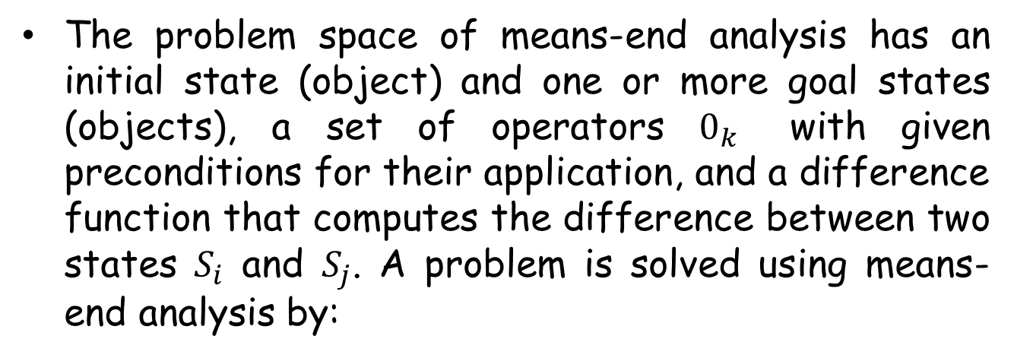
Mean End Analysis

Slide 5
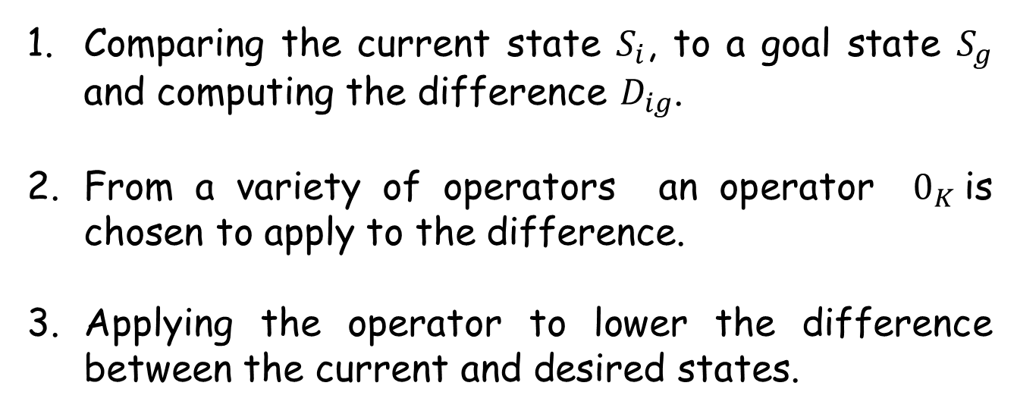
Mean End Analysis

Slide 6
Mean End Analysis
We detect the differences between the existing state and the goal state during the MEA process. Once these differences have increased, the current state is saved, a subgoal is created and means-end analysis is applied recursively to reduce the difference. If the subgoal is solved, the saved state is restored and work is resumed on the original problem. In this way choosing different operator and defining sub goal is known as Operator Sub goaling.

Slide 7
Mean End Analysis (Mean End Analysis)
As an example, in proving theorems in propositional logic, some common differences that occur are a variable may appear in one object and not in the other, a variable may occur a different number of times between two objects, object will have different signs or different connectives, associative groupings will differ, and so on..

Slide 8
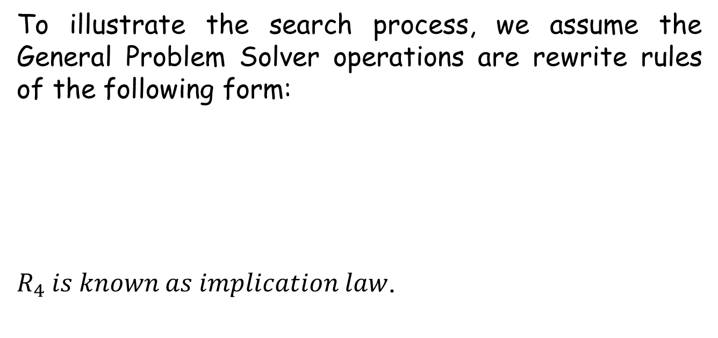
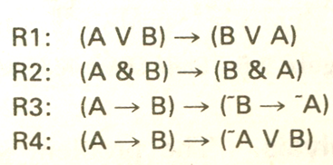
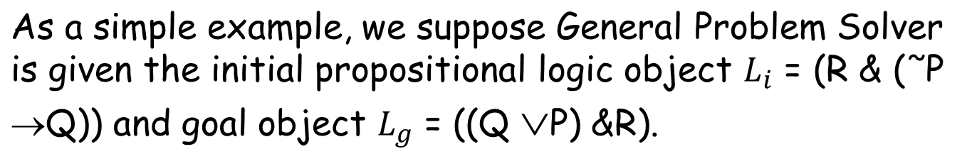
Mean End Analysis (Mean End Analysis)

Slide 9
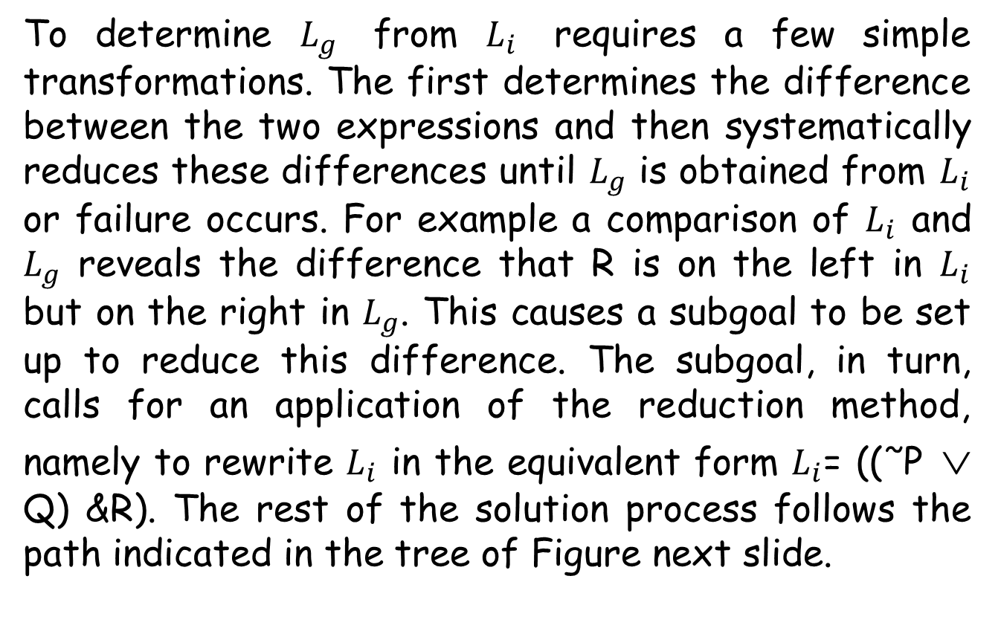
Mean End Analysis (Mean End Analysis)

Slide 10
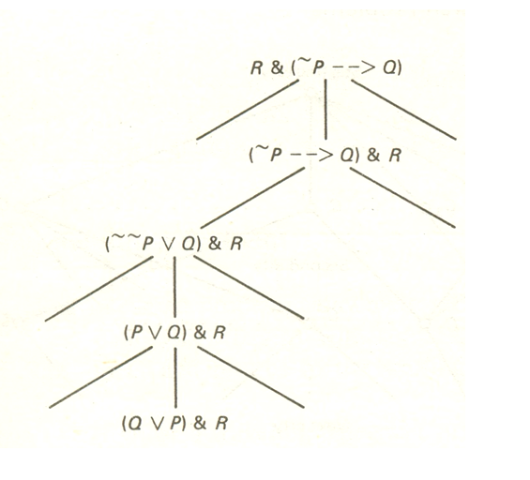
Mean End Analysis (Mean End Analysis)

Slide 11
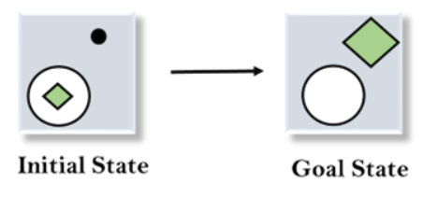
Example 2 of Mean End Analysis
Let's take an example where we know the initial state and goal state as given below. In this problem, we need to get the goal state by finding differences between the initial state and goal state and applying operators.

Slide 12
Example of Mean End Analysis
Solution:
To solve the above problem, we will first find the differences between initial states and goal states, and for each difference, we will generate a new state and will apply the operators. The operators we have for this problem are:
Move
Delete
Expand

Slide 13

Example of Mean End Analysis
Step 1 Evaluating the Initial State
In the first step, we will evaluate the initial state and will compare the initial and Goal state to find the differences between both states.

Slide 14
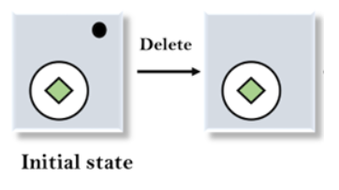
Example of Mean End Analysis
2. Applying Delete Operator
As we can check the first difference is that in goal state there is no dot symbol which is present in the initial state, so, first we will apply the Delete operator to remove this dot.

Slide 15
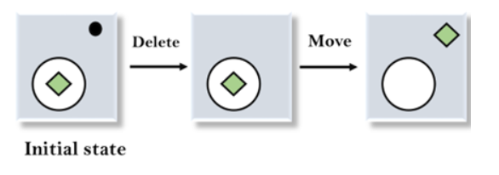
Example of Mean End Analysis
3. Applying Move Operator
After applying the Delete operator, the new state occurs which we will again compare with goal state. After comparing these states, there is another difference that is the square is outside the circle, so, we will apply the Move Operator.

Slide 16
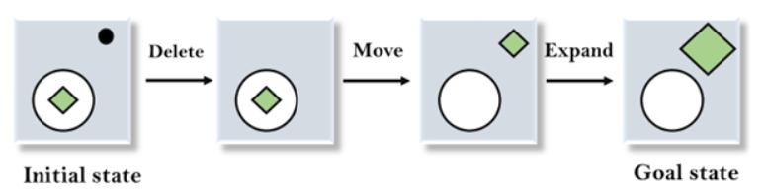
Example of Mean End Analysis
4. Applying Expand Operator
Now a new state is generated in the third step, and we will compare this state with the goal state. After comparing the states there is still one difference which is the size of the square, so, we will apply Expand operator, and finally, it will generate the goal state.

Slide 17
Ununiformed or blind-Search
Search problems can be classified by the amount of information that is available to the search process. Such information might relate to the problem space as a whole or to only some states. It may be available a priori or only after a node has been expanded. In a worst situation the only information available will be the ability to distinguish goal from nongoal nodes.
When no further information is known a priori, a search program must perform a blind or uninformed search.

Slide 18
Ununiformed or blind-Search
A blind or uninformed search algorithm is one that uses no information other than the initial state, the search operators etc.
A blind search should proceed in a systematic way by exploring nodes in some predetermined order or simply by selecting nodes at random. We consider only systematic search procedures in this section.

Slide 19
Breadth-First Search
Breadth-first searches are performed by exploring all nodes at a given depth before proceeding to the next level. This means that all immediate children of nodes are explored before any of the children’s children are considered. . It has the obvious advantage of always finding a minimal path length solution when one exists. However, a great many nodes may need to be explored before a solution is found, especially if the tree is very full.

Slide 20
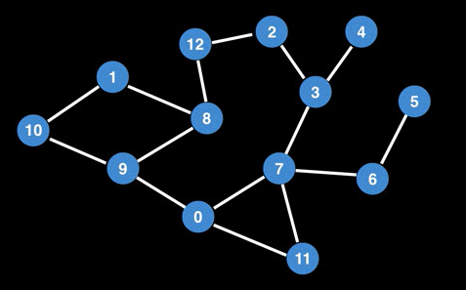
Breadth-First Search
A Breadth-first search starts at some arbitrary node of a graph and explores the neighbor nodes first, before moving to the next level neighbors.

Slide 21
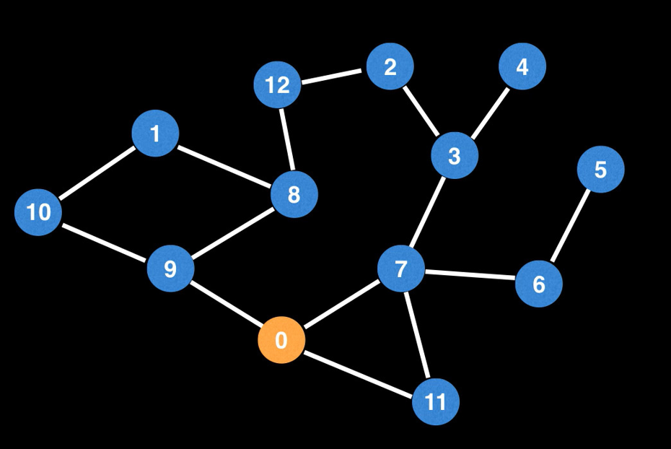
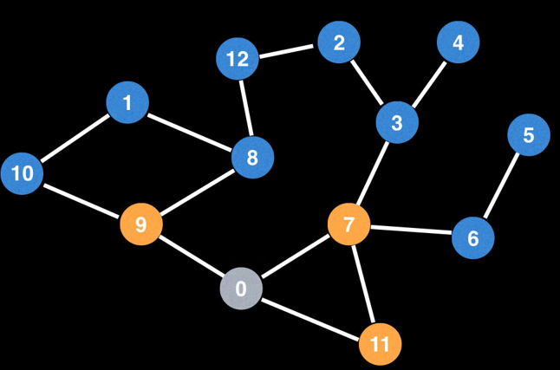
Breadth-First Search
In a sense a Breadth –First search explores nodes in layers.
So we start BFS at zero we will visit 0 first then visit all zeroes neighbors. Then we would visit all zeroes neighbors. Then we would visit all zeroes neighbors the nodes in yellow before moving onto the next layer of nodes,

Slide 22
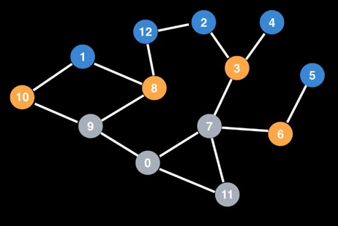
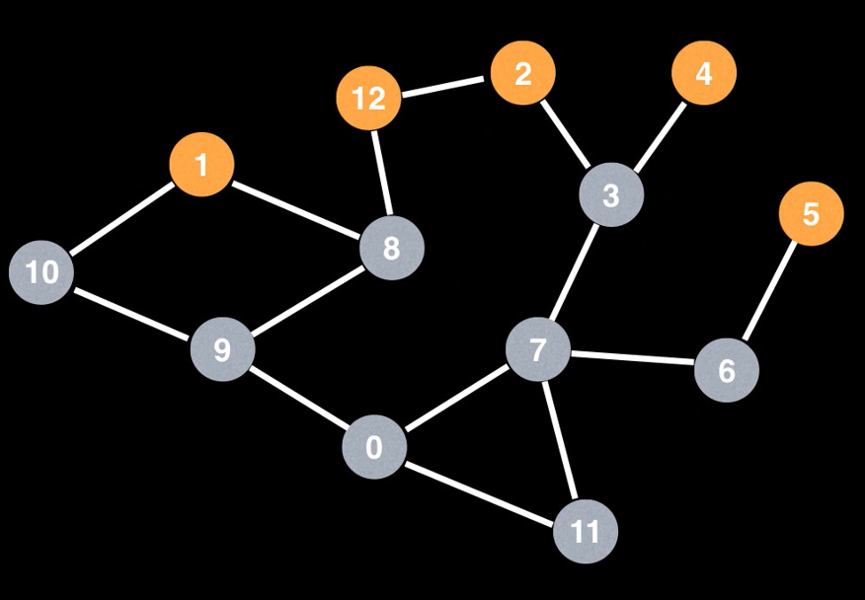
Breadth-First Search
Then we would visit all those neighbors and so on.

Slide 23
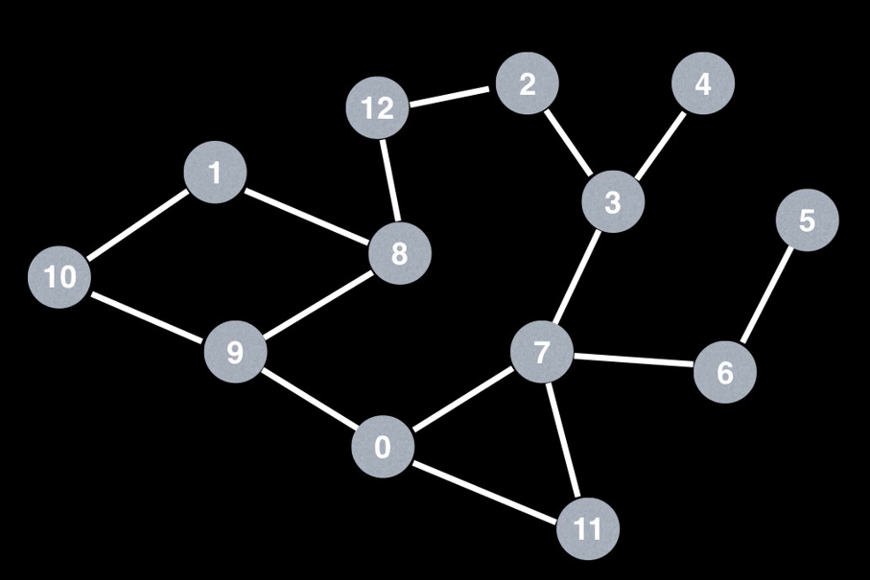
Breadth-First Search
So a Breadth first graph explore a graph in a layered fashion. It does this by maintaining a queue of which node it should visit next. This is most easily seen with an example.

Slide 24
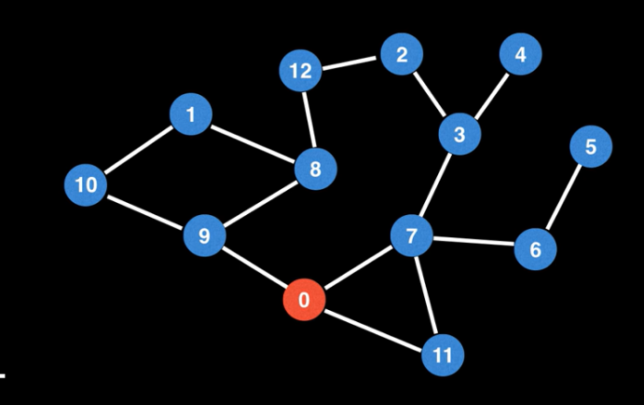

Breadth-First Search
let’s begin a breadth first search at node 0 once more. So lets add 0 to the queue on the left. I will denote, the current node in red, so 0 is the current node and we want to explore all zeroes unvisited neighbors and add them to the queue.

Slide 25
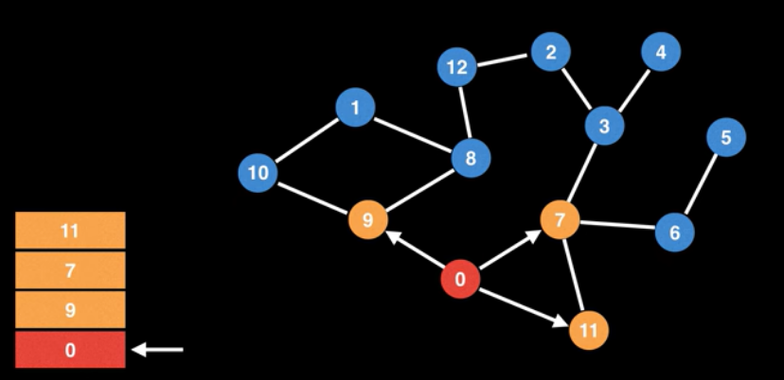
Breadth-First Search
so we would add 9 to the queue, 7 to the queue and 11 to the queue so 0 has no more unvisited neighbors so we move on.

Slide 26
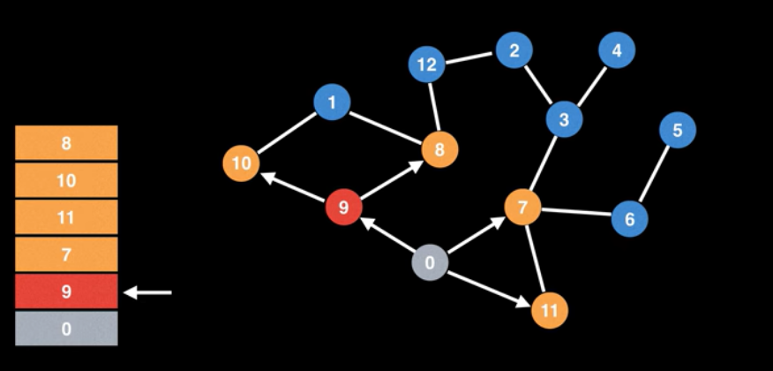
Breadth-First Search
9 is next up in the queue. So we add all nines unvisited neighbors to the queue, so that is 10 and 8 then there are no more neighbors of 9 to visit so we move on to the next node

Slide 27
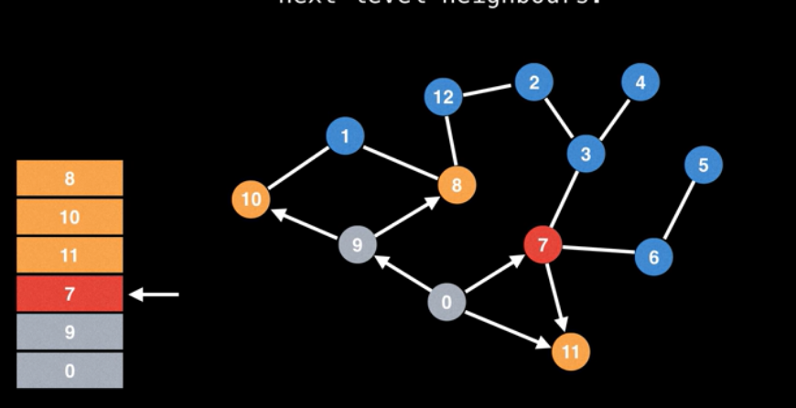
Breadth-First Search
In our queue which is 7 then we add all seven’s unvisited neighbors.
To the queue, so we try and visit node 11 but node 11 is already in queue so we don’t want to add it again so we skip it.

Slide 28
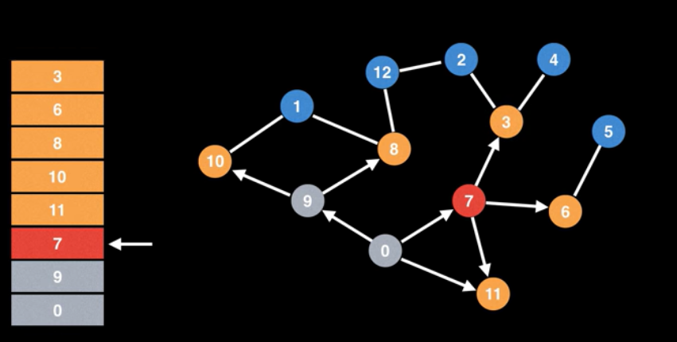
Breadth-First Search
Then we add 6 to the queue and 3 to the queue then this process goes on and on until we run out of nodes in the queue.

Slide 29
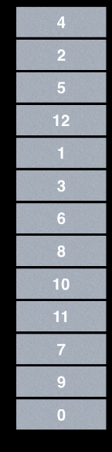
Breadth-First Search
The next node to be explored is 10 which has one child node 1. Then we will explore 8. Then we will explore 8 which has one child node 12. Then we will explore 6 which has one child node 5. Then we will explore 2 which has no child node and finally 4 which has no child node. That’s how we do a Breadth First Search.

Slide 30
Breadth-First Search
For more example watch:-
https://youtu.be/SZ2a668G6vA
For the example provided in presentation watch:-
https://youtu.be/oDqjPvD54Ss

Slide 31
Depth-First Search
Depth-first searches are performed by diving downward into a tree as quickly as possible. It does this by always generating a child node from the most recently expanded node, then generating that child’s children, and so on until a goal is found or some cutoff depth point d is reached. If a goal is not found when a leaf node is reached or at the cutoff point, the program backtracks to the most expanded node and generates another of its children. This process continues until a goal is found or failure occurs.

Slide 32
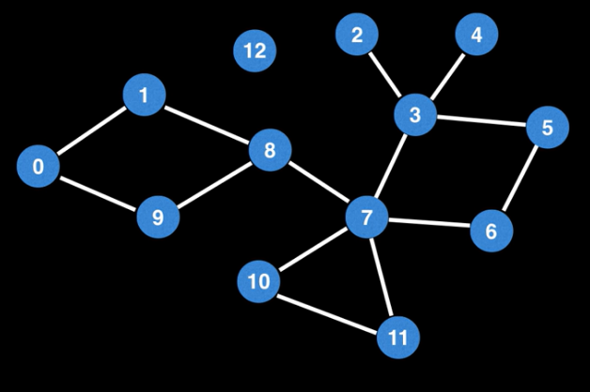
Depth-First Search

Slide 33
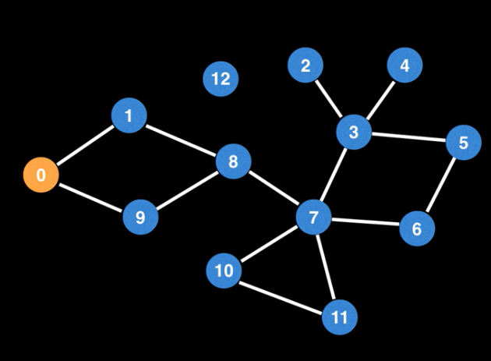
Depth-First Search
We arbitrarily pick a node go to from node 0. Pick an edge outwards from node 0.

Slide 34
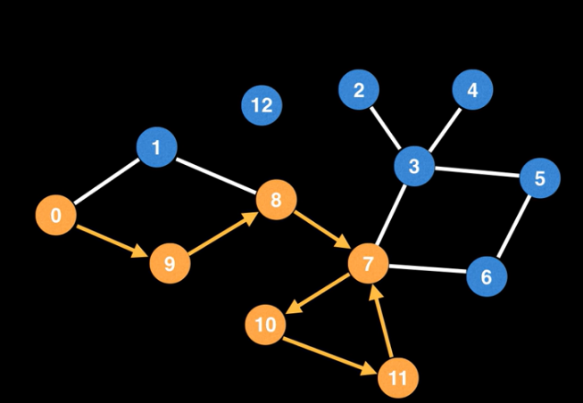
Depth-First Search
Once at 9 pick an edge outwards from node 9. Then pick an edge outwards from 8. Then we choose 7. From 7 there are plenty of edges to choose from. 7 to 10 , 10 to 11 and again 11 to 7. Make sure you revisit already revisited nodes or the node currently being visited.

Slide 35
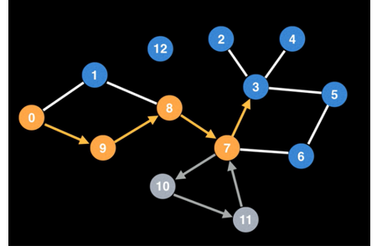
Depth-First Search
So we have to backtrack. For backtracking we have to label edges and nodes gray so backtrack all the way back to 7. So, we are not exploring finished 7 because there are other edges to picked.

Slide 36
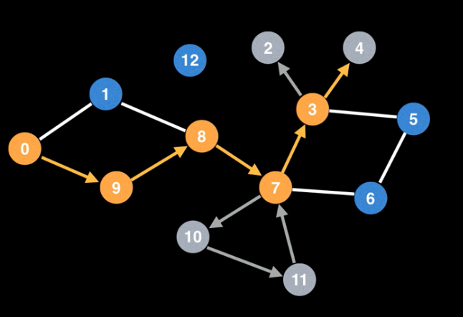
Depth-First Search
So we have to backtrack. For backtracking we have to label edges and nodes gray so backtrack all the way back to 7. So, we are not exploring finished 7 because there are other edges to picked. So I am going to go to node 3 and from node 3 we are going to node 2.

Slide 37
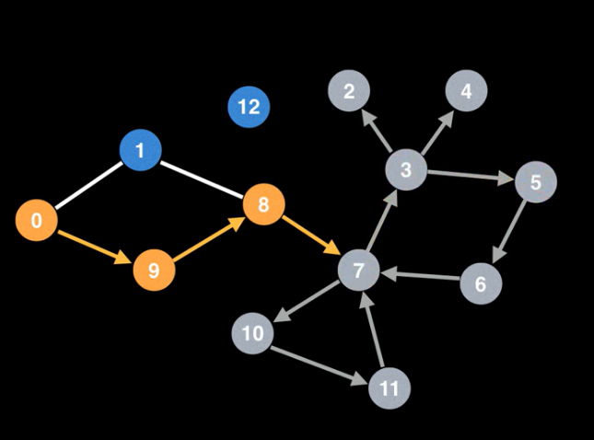
Depth-First Search
Node 2 is a dead end. So we backtrack and go to node 4 which is also dead end. So we back track to 3, and pick node 3’s last edge node 5. 5 to 6 and 6 to 7.

Slide 38
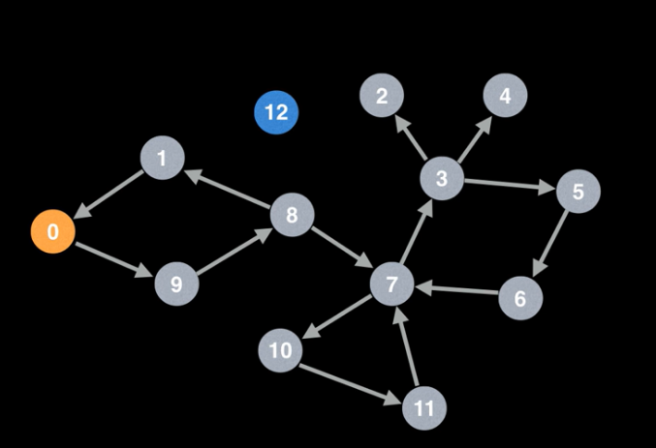
Depth-First Search
Can’t go to 7 because we already visited 7. So backtrack all the back to 8. From 8 it goes to node 1. Then back to node 0.

Slide 39
Depth-First Search
Can’t go to 7 because we already visited 7. So backtrack all the back to 8. From 8 it goes to node 1. Then back to node 0. This was one depth-first search traversal, however it can go on in lot of different ways.

Slide 40
Depth-First Search
Advantages
Low space complexity
Good chance of success when there are many solutions
Complete if there is a solution shorter than the depth limit
Disadvantages
Without the depth limit search may continue down an infinite branch
Solutions longer than the depth limit will not be found
The solution found may not be the shortest solution

Slide 41
Depth-First Search
For more example watch:-
https://youtu.be/dWpvK-8uAqM
https://youtu.be/NUlKH29gg6I
For the example provided in presentation watch:-
https://youtu.be/7fujbpJ0LB4

Slide 42
End

